Slide 1
Module 4
DATA LINK LAYER

Slide 2
CONTENTS
Introduction
Framing
Error detection methods-Parity check,CRC,Checksum

Slide 3
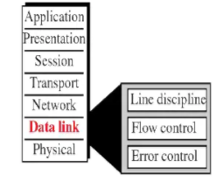
INTRODUCTION
deals with procedures for communication between two adjacent nodes—node-to-node communication.
Data link control (DLC) functions include
Framing
flow and error Control
error detection and correction.

Slide 4
FRAMING
Data transmission in the physical layer means moving bits in the form of a signal from the source to the destination.
The data-link layer, on the other hand, needs to pack bits into frames, so that each frame is distinguishable from another
Framing in the data-link layer separates a message from one source to a destination by adding a sender address and a destination address.

Slide 5
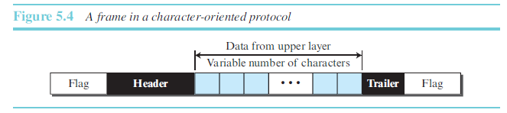
Character-Oriented Framing
In character-oriented (or byte-oriented) framing, data to be carried are 8-bit characters
The header which carries the source and destination addresses and other control information, and the trailer, which carries error detection redundant bits, are also multiples of 8 bits.
To separate one frame from the next, an 8-bit (1-byte) flag is added at the beginning and the
end of a frame.
The flag, composed of protocol-dependent special characters, signals the start or end of a frame.
Character-oriented framing was used when only text was exchanged by the data-link layers.

Slide 6
Byte stuffing
Byte stuffing is the process of adding one extra byte whenever there is a flag or escape character in the text
In byte stuffing (or character stuffing), a special byte is added to the data section of the frame when there is a character with the same pattern as the flag.
The data section is stuffed with an extra byte.
This byte is usually called the escape character (ESC) and has a predefined bit pattern.
Whenever the receiver encounters the ESC character, it removes it from the data section and treats the next character as data, not as a delimiting flag.

Slide 7
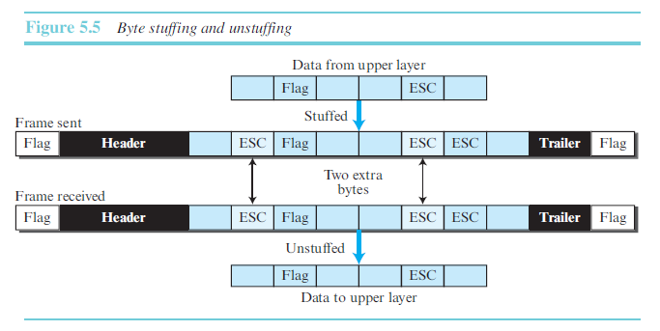

Slide 8
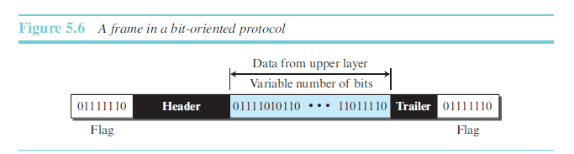
Bit-Oriented Framing
In addition to headers (and possible trailers), we still need a delimiter to separate one frame from the other.
Most protocols use a special 8-bit pattern flag, 01111110, as the delimiter to define the beginning and the end of the frame

Slide 9
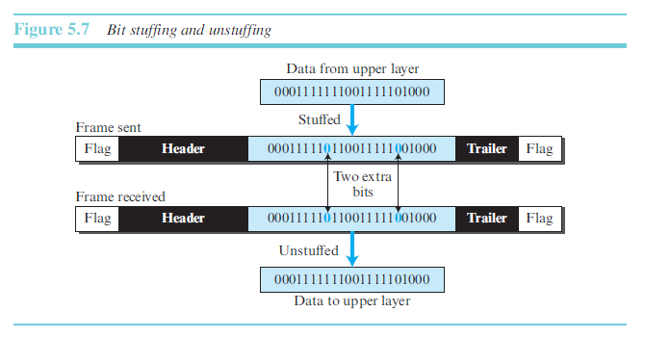
This flag can create the same type of problem we saw in the character-oriented protocols. That is, if the flag pattern appears in the data, we need to somehow inform the receiver that this is not the end of the frame. We do this by stuffing 1 single bit (instead of 1 byte) to prevent the pattern from looking like a flag. The strategy is called bit stuffing.
Bit stuffing is the process of adding one extra 0 whenever five consecutive 1s follow a 0 in the data, so that the receiver does not mistake the pattern 0111110 for a flag.

Slide 10
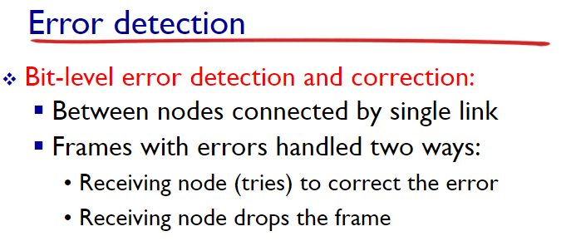

Slide 11
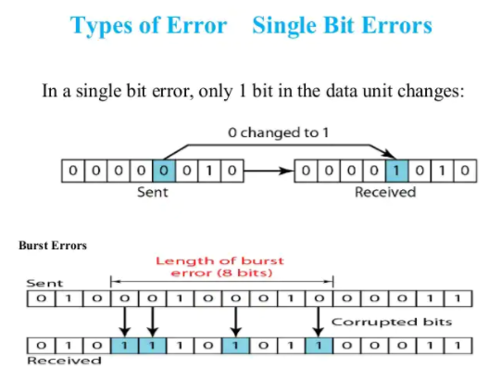

Slide 12
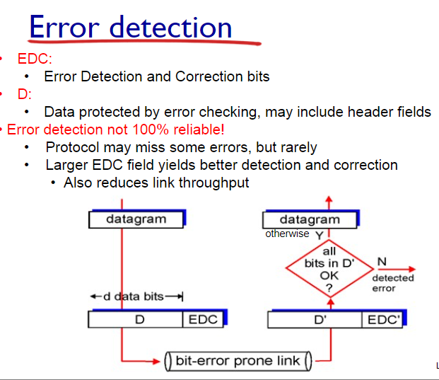

Slide 13
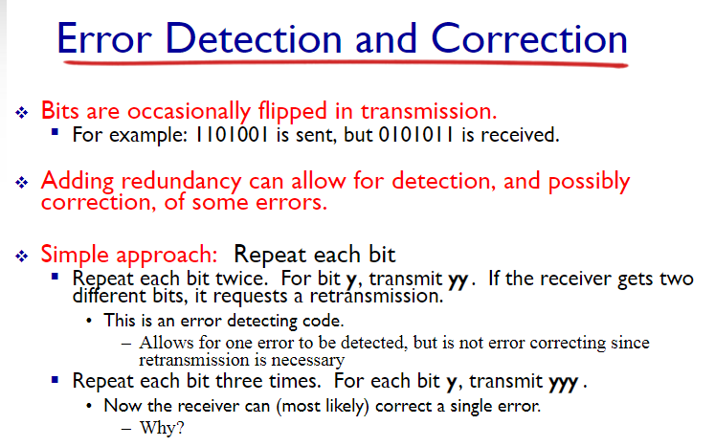

Slide 14
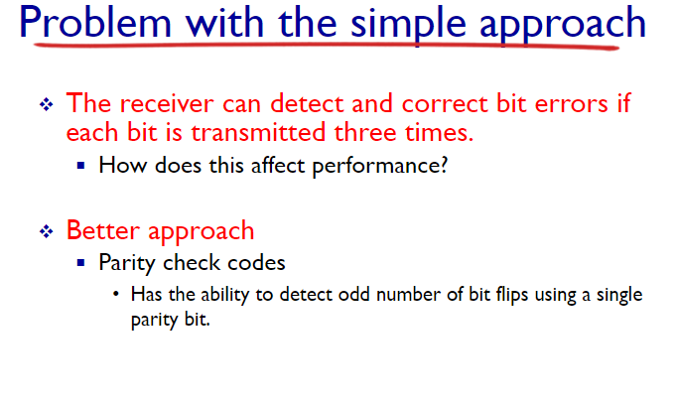

Slide 15
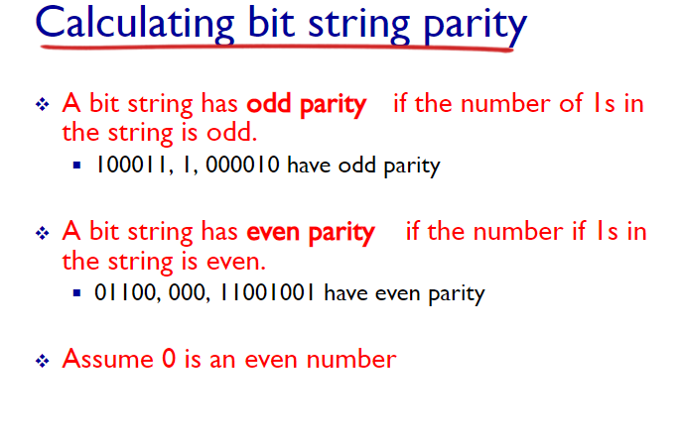

Slide 16
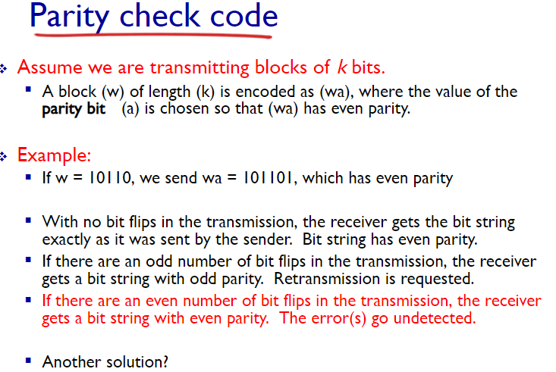

Slide 17
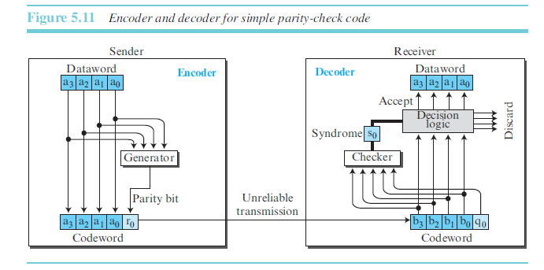
A parity-check code can detect an odd number of errors

Slide 18
Cyclic Codes
In a cyclic code, if a codeword is cyclically shifted (rotated), the result is another codeword.
For example, if 1011000 is a codeword and we cyclically left-shift, then 0110001 is also a codeword.
In this case, if we call the bits in the first word a0 to a6, and the bits in the second word
b0 to b6, we can shift the bits by using the following:
b1 = a0 b2 = a1 b3 = a2 b4 = a3 b5 = a4 b6 = a5 b0 = a6

Slide 19
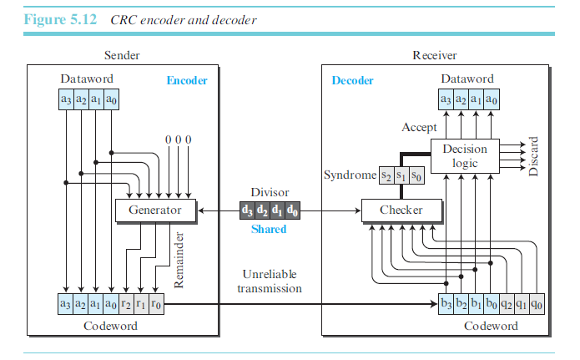
Cyclic Redundancy Check [https://www.youtube.com/watch?v=-oUrtqvUA2o]
We can create cyclic codes to correct errors.
A type of cyclic codes called the cyclic redundancy check (CRC) that is used in networks such as LANs and WANs.

Slide 20
Steps
dataword has k bits (4 here);
the codeword has n bits (7 here).
The size of the dataword is augmented by adding n − k (3 here) 0s to the right-hand side
of the word.
The n-bit result is fed into the generator.
The generator uses a divisor of size n − k + 1 (4 here), predefined and agreed upon.
The generator divides the augmented dataword by the divisor (modulo-2 division).
The quotient of the division is discarded;
the remainder (r2r1r0) is appended to the dataword to create the codeword.
The decoder receives the codeword (possibly corrupted in transition).
A copy of all n bits is fed to the checker, which is a replica of the generator.
The remainder produced by the checker is a syndrome of n − k (3 here) bits, which is fed to the decision logic analyzer. The analyzer has a simple function. If the syndrome bits are all 0s, the 4 leftmost bits of the codeword are accepted as the dataword (interpreted as no error);
otherwise, the 4 bits are discarded (error).

Slide 21
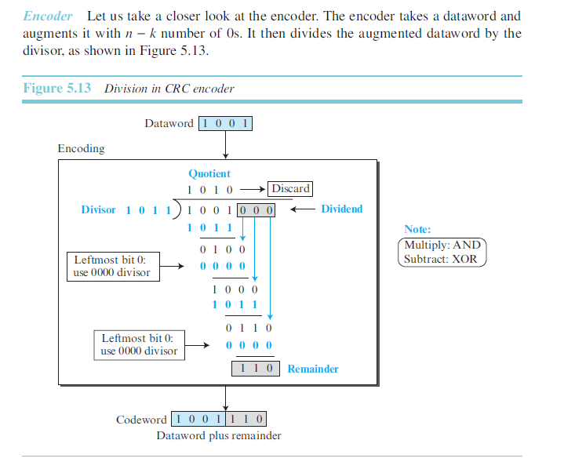
Sender

Slide 22
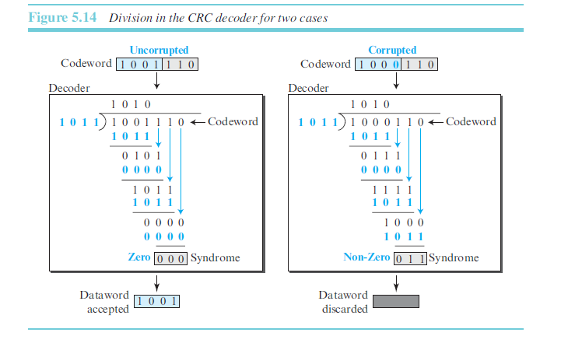
Reciver

Slide 23
Checksum
Checksum is an error-detecting technique that can be applied to a message of any length.
In the Internet, the checksum technique is mostly used at the network and transport layer rather than the data-link layer

Slide 24
At the source, the message is first divided into m-bit units.
The generator then creates an extra m-bit unit called the checksum, which is sent with the message.
At the destination, the checker creates a new checksum from the combination of the message and sent checksum.
If the new checksum is all 0s, the message is accepted; otherwise, the message is discarded .
Note that in the real implementation, the checksum unit is not necessarily added at the end of the message; it can be inserted in the middle of the message.

Slide 25
Traditional checksum
Suppose the message is a list of five 4-bit numbers that we want to send to a destination. In addition to sending these numbers, we send the sum of the numbers. For example, if the set of numbers is (7, 11, 12, 0, 6), we send (7, 11, 12, 0, 6, 36), where 36 is the sum of the original numbers. The receiver adds the five numbers and compares the result with the sum. If the two are the same, the receiver assumes no error, accepts the five numbers, and discards the sum. Otherwise, there is an error somewhere and the message not accepted

Slide 26
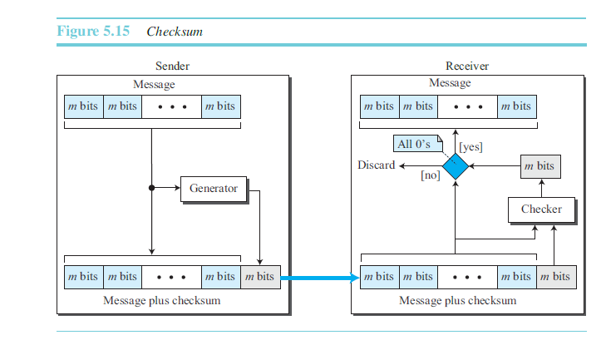
One’s Complement Addition [https://www.youtube.com/watch?v=AtVWnyDDaDI]

Slide 27
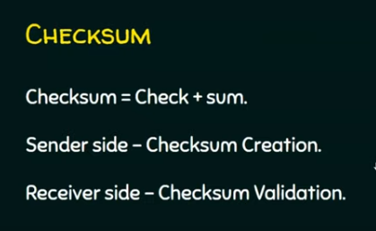

Slide 28
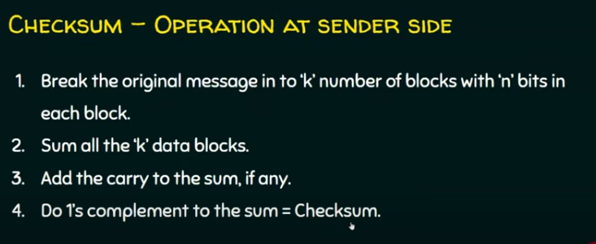

Slide 29
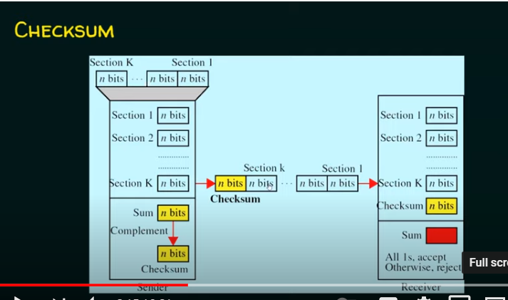

Slide 30
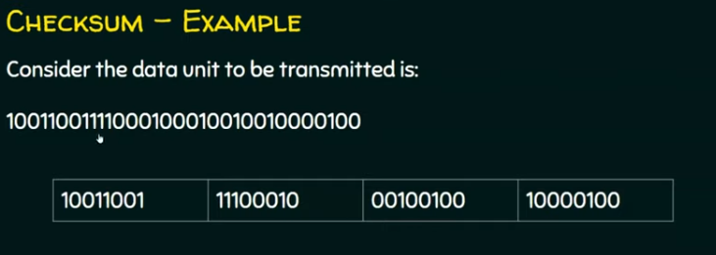

Slide 31
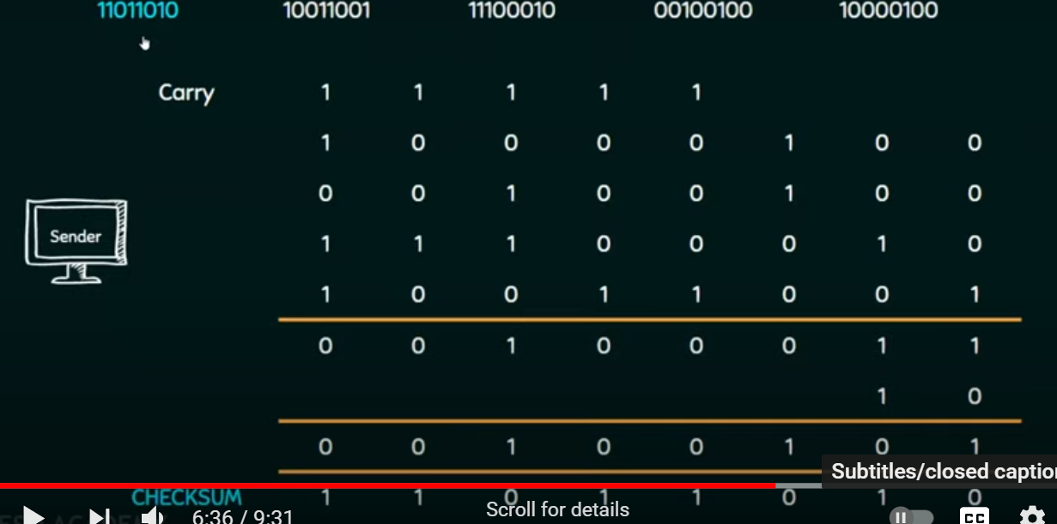

Slide 32
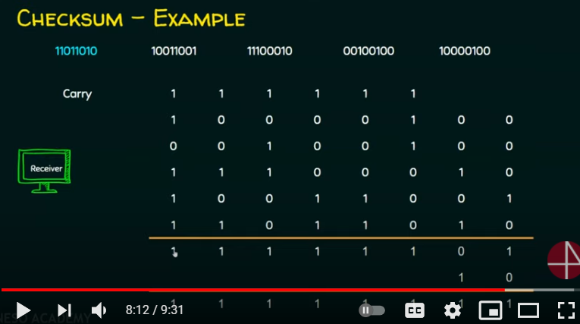

Slide 33
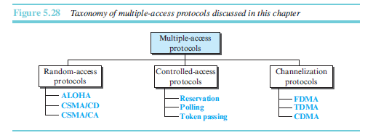
Multiple access protocols
(collision and token based)
data-link layer is divided into two sublayers:
data link control (DLC)
media access control (MAC).
When nodes or stations are connected and use a common link, called a multipoint or broadcast link, we need a multiple-access protocol to coordinate access to the link

Slide 34
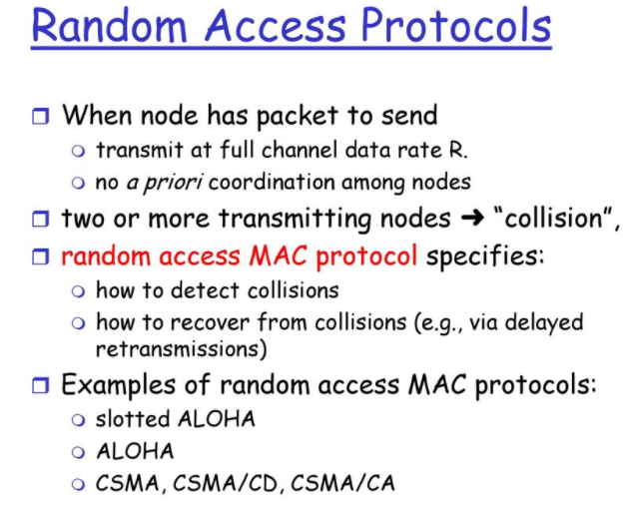

Slide 35
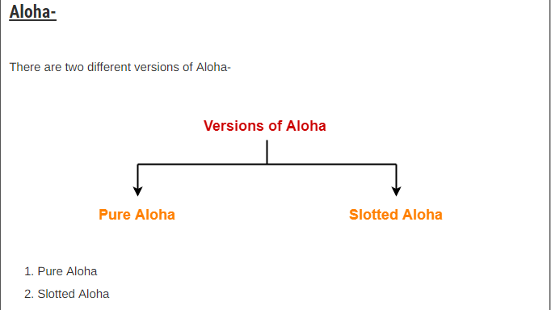

Slide 36
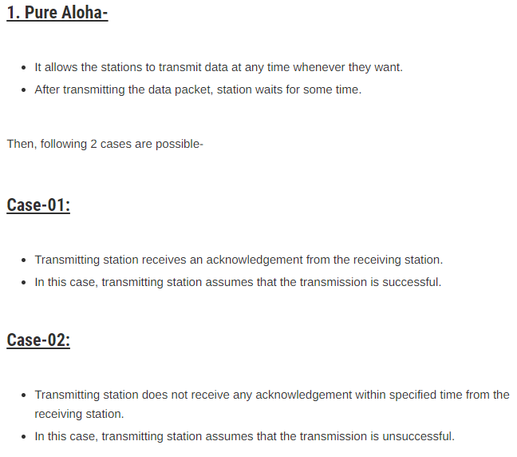
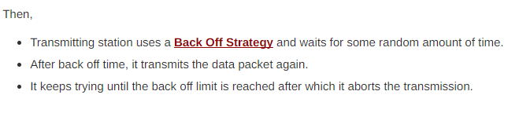
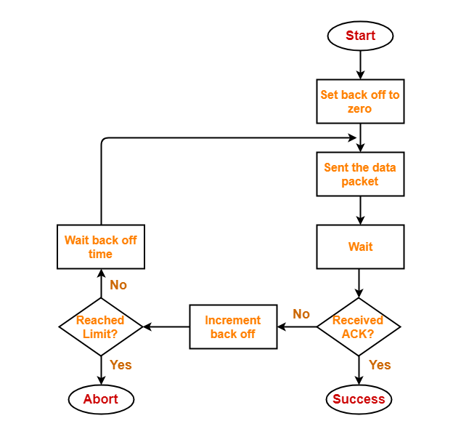

Slide 37
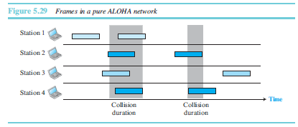

Slide 38
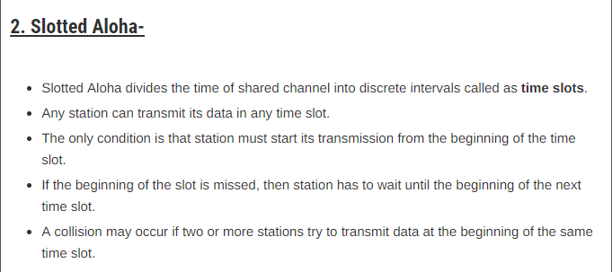
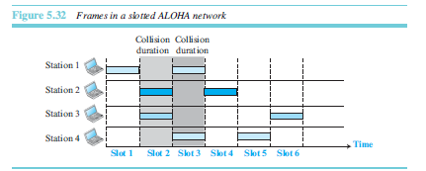

Slide 39
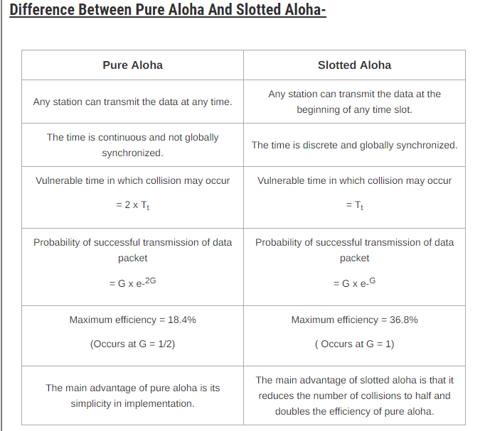

Slide 40
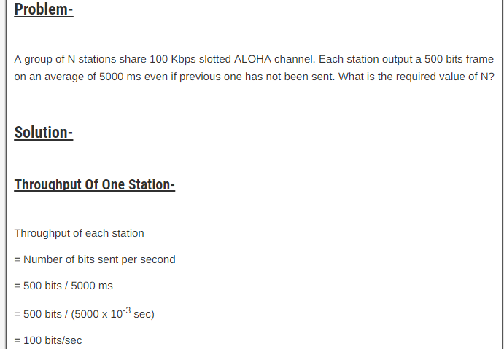
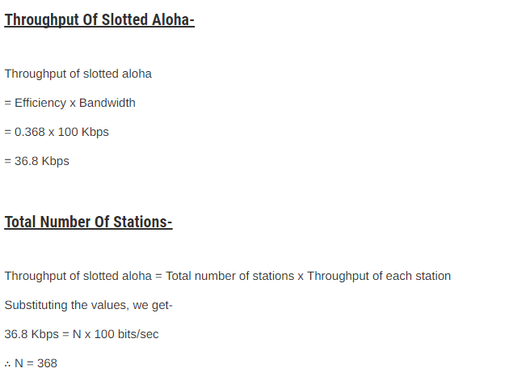

Slide 41
HOME WORK [SOLUTION:PAGE:434-435
A slotted ALOHA network transmits 200-bit frames using a shared channel with a 200-kbps
bandwidth. Find the throughput if the system (all stations together) produces
a. 1000 frames per second.
b. 500 frames per second.
c. 250 frames per second.

Slide 42
CSMA
Carrier sense multiple access (CSMA) requires that each station first listen to the medium (or check the state of the medium) before sending.
The station is required to first sense the medium (for idle or busy) before transmitting data.
If it is idle then it sends data
otherwise it waits till the channel becomes idle.
However there is still chance of collision in CSMA due to propagation delay.
For example, if station A wants to send data, it will first sense the medium.If it finds the channel idle, it will start sending data. However, by the time the first bit of data is transmitted (delayed due to propagation delay) from station A, if station B requests to send data and senses the medium it will also find it idle and will also send data. This will result in collision of data from station A and B.

Slide 43
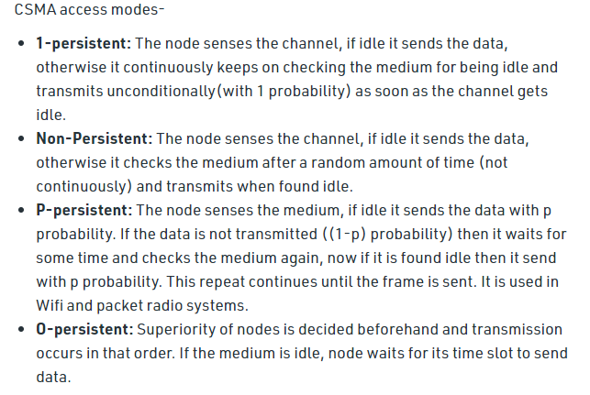

Slide 44
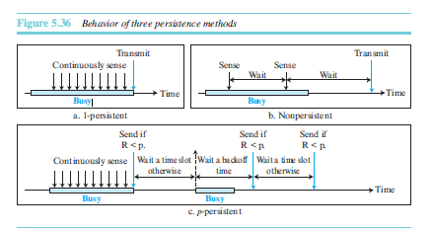
Persistence Methods

Slide 45
Contention Protocols (Cont’d)
CSMA (Carrier Sense Multiple Access)
  Improvement: Start transmission only if no transmission is ongoing
CSMA/CD (CSMA with Collision Detection)
  Improvement: Stop ongoing transmission if a collision is detected
CSMA/CA (CSMA with Collision Avoidance)
  Improvement: Wait a random time and try again when carrier is quiet. If still quiet, then transmit
CSMA/CA with ACK
CSMA/CA with RTS/CTS

Slide 46
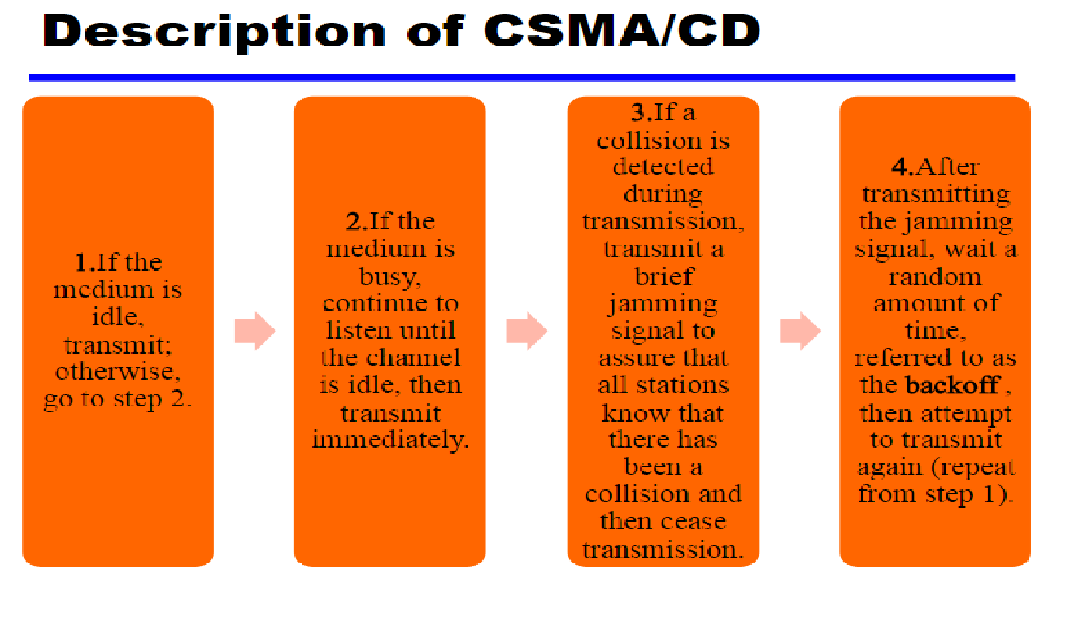

Slide 47
CSMA/CD (CSMA with Collision Detection)
In CSMA, if 2 terminals begin sending packet at the same time, each will transmit its complete packet (although collision is taking place).
Wasting medium for an entire packet time.
CSMA/CD
Step 1: If the medium is idle, transmit
Step 2: If the medium is busy, continue to listen until the channel is idle then transmit
Step 3: If a collision is detected during transmission, cease transmitting
Step 4: Wait a random amount of time and repeats the same algorithm

Slide 48
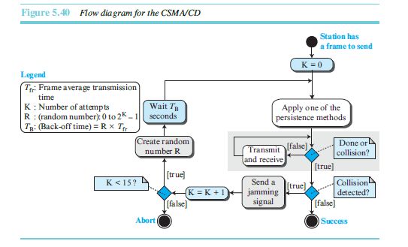

Slide 49
CSMA/CA (CSMA with collision Avoidance)
All terminals listen to the same medium as CSMA/CD.
Terminal ready to transmit senses the medium.
If medium is busy it waits until the end of current transmission.
It again waits for an additional predetermined time period DIFS (Distributed inter frame Space).
Then picks up a random number of slots (the initial value of backoff counter) within a contention window to wait before transmitting its frame.
If there are transmissions by other terminals during this time period (backoff time), the terminal freezes its counter.
It resumes count down after other terminals finish transmission + DIFS. The terminal can start its transmission when the counter reaches to zero.

Slide 50
CSMA/CA (Cont’d)
Node A’s frame
Node B’s frame
Node C’s frame
Delay: B
Delay: C
Time
Nodes B & C sense the medium
Nodes C starts transmitting.
Nodes B resenses the medium and transmits its frame.
Node C freezes its counter.
Nodes C resenses the medium and starts decrementing its counter.

Slide 51
CSMA/CA Explained
DIFS
DIFS
Contention window
Contention
window
Medium Busy
Next Frame
Time
Defer access
Slot
Backoff after defer
DIFS – Distributed Inter Frame Spacing

Slide 52
CSMA/CA with ACK
Immediate Acknowledgements from receiver upon reception of data frame without any need for sensing the medium.
ACK frame transmitted after time interval SIFS (Short Inter-Frame Space) (SIFS < DIFS)
Receiver transmits ACK without sensing the medium.
If ACK is lost, retransmission done.

Slide 53
CSMA/CA/ACK
DIFS
Time
Data
Source
SIFS
ACK
Destination
DIFS
Contention window
Next Frame
Other
Defer access
Backoff after defer
SIFS – Short Inter Frame Spacing

Slide 54
CSMA/CA with RTS/CTS
Transmitter sends an RTS (request to send) after medium has been idle for time interval more than DIFS.
Receiver responds with CTS (clear to send) after medium has been idle for SIFS.
Then Data is exchanged.
RTS/CTS is used for reserving channel for data transmission so that the collision can only occur in control message.

Slide 55
CSMA/CA with RTS/CTS (Cont’d)
DIFS
SIFS
Data
Time
Source
RTS
SIFS
SIFS
Destination
CTS
ACK
DIFS
Contention window
Next Frame
Other
Defer access
Backoff after defer

Slide 56
RTS/CTS
Node A
Node B
Propagation delay
RTS
CTS
Data
ACK

Slide 57
CONTROLLED ACCESS
In controlled access, the stations consult one another to find which station has the right to send. A station cannot send unless it has been authorized by other stations. We discuss three popular controlled-access methods.
Reservation
Polling
Token Passing
:

Slide 58
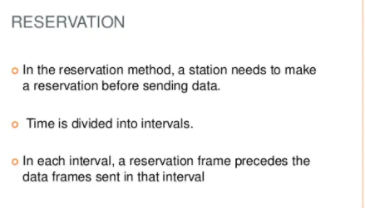

Slide 59
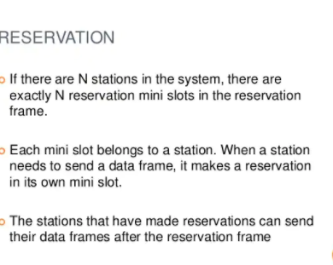

Slide 60
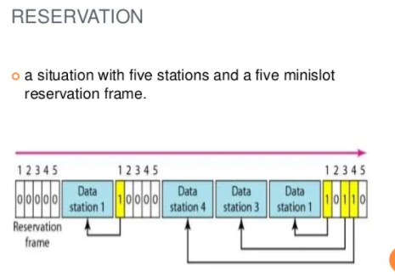

Slide 61
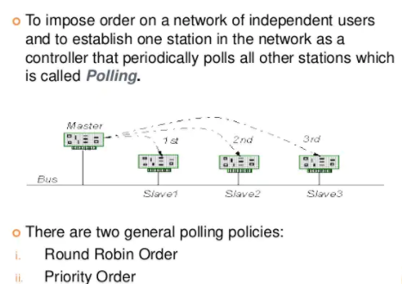
Polling

Slide 62
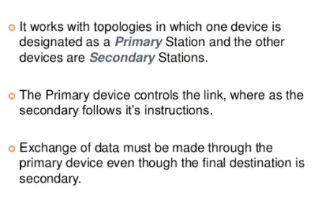

Slide 63
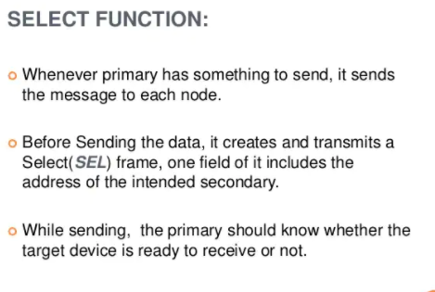

Slide 64
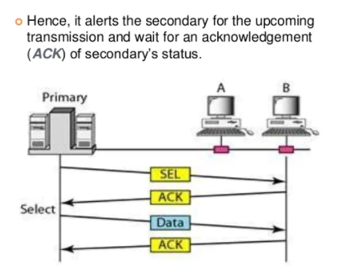

Slide 65
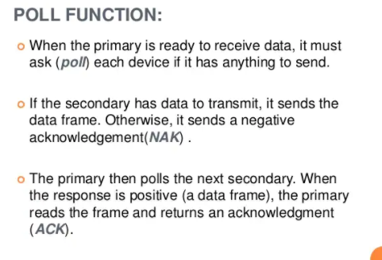

Slide 66
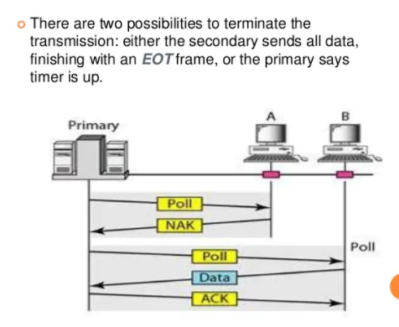

Slide 67
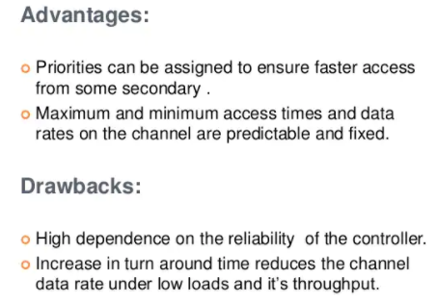

Slide 68
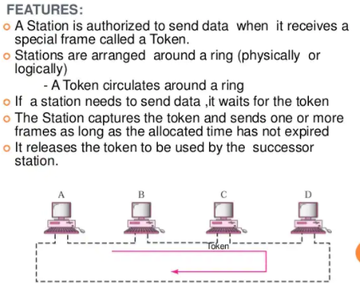
Token passing

Slide 69


Slide 70


Slide 71


Slide 72


Slide 73


Slide 74


Slide 75


Slide 76


Slide 77


Slide 78


IEEE 802.3Ethernet

Slide 79

1.IEEE STANDARDS

Slide 80
IEEE has subdivided the data-link layer into two sublayers:
logical link control (LLC)
  flow control, error control, and part of the framing duties are collected into one sub layer called the logical link control
  Media access control (MAC)
  Media access control that defines the specific access method for each LAN. For example, it defines CSMA/CD as the media access method for Ethernet LANs and defines the token-passing method for Token Ring and Token Bus LANs.

Slide 81

Standard Ethernet

Slide 82


Slide 83


Slide 84


Slide 85


Slide 86


Slide 87


Slide 89


Slide 90


Slide 91


Slide 92


Slide 93


Slide 94



Slide 95


Slide 96


Slide 97


Slide 98

Implementation of standard Ethernet

Slide 99

Fast Ethernet (100 Mbps)

Slide 100


Slide 101


Slide 102


Slide 103


Slide 104


Slide 105


Slide 106


